Slide 1
Video Compression and Coding using Transforms, Sub-band Filters and Motion Compensation
Group 5: Lab 2 Exercise
Multimedia and Video Communications SSY 150
Haitham Babbili
Olalekan Peter Adare

Slide 2

Content
Video Compression
Compression Modes
DCT and Block-based DCT
Sub-band filter
Task1
Task 2
Task 3
Task 5 & 6
Task 7 & 8
Conclusion

Slide 3
Video Compression
Video compression is the process of reducing the redundant and irrelevant information used to encode a video file.
It reduces spatial redundancy within a frame, and also reduces temporal redundancy between frames.
This gives benefits in saving storage resources and offering lower transmission bandwidth for its transmission.
Compression can be lossy or lossless
Lossy Compression: This reduces the size by deleting unnecessary information, and the complexity of existing information.
Lossless Compression: This removes bits by locating and removing statistical redundancies.
Notes:
-Efficient Bandwidth Utilization
-Less Storage requirement

Slide 4
Compression Modes
Intra mode
Removal of small energy coefficients from the high frequency components
High energy components are in the lower frequencies, which contains edges, texture...
This is also referred to as 2D image
Examples of intra mode compression techniques are DCT and sub-band filter
Inter mode
This is mostly used in video coding
It achieves compression by comparing information in the prediction (P) and bidirectional (B) image frames
First, find the motion vector and then based on the previous image, it can predict the new image by using the motion vector.
Video compression is largely based on motion compensation.
Notes:
DCT: Discrete Cosine Transform

Slide 5
DCT and Block-based DCT
DCT
Decompose the data into low frequency and high frequency components
Basic computation is the transformation of N x N image from spatial domain to time domain.
Block-based DCT
Converts the non-stationarty image to blocks and considers these blocks as stationary. Then, DCT is applied on each of these blocks
Usually the block size is 8x8. This gives less computation and less memory requirement . It can also be 16 x 16 block size
Then, the high frequency coefficients are set to zero to reduce the redundancy in the image
Notes:
A discrete cosine transform(DCT) expresses a finite sequence of data points in terms of a sum of cosine functions oscillating at different frequencies.

Slide 6
Sub-band filter
Decompose the signal into multiband where the number of bands is equal to the size of the transformation matrix.
Then apply a series of filters, to separate out the low frequency part and ignore the high frequency part
This is more efficient, as the image does not have the block artifact as compared to block based DCT
This guarantees a good quality of the reconstructed image.

Slide 7
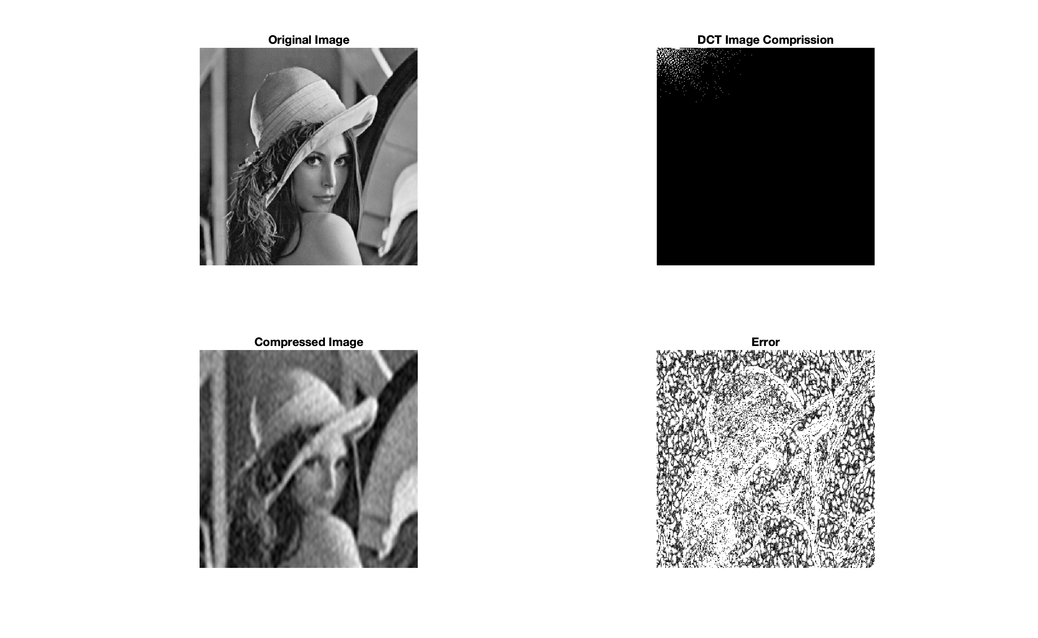
Task 1: 2D DCT for image compression
The image is imported and normalized (0,1)
Apply 2D DCT to the whole image
Image compression is achieved by
removing small value DCT coefficients
Global thresholding was used with a target of
98% compression ratio
Compressed image is generated by inverse DCT
PSNR and MSSIM values were calculated and used
for image quality evaluation.

Slide 8
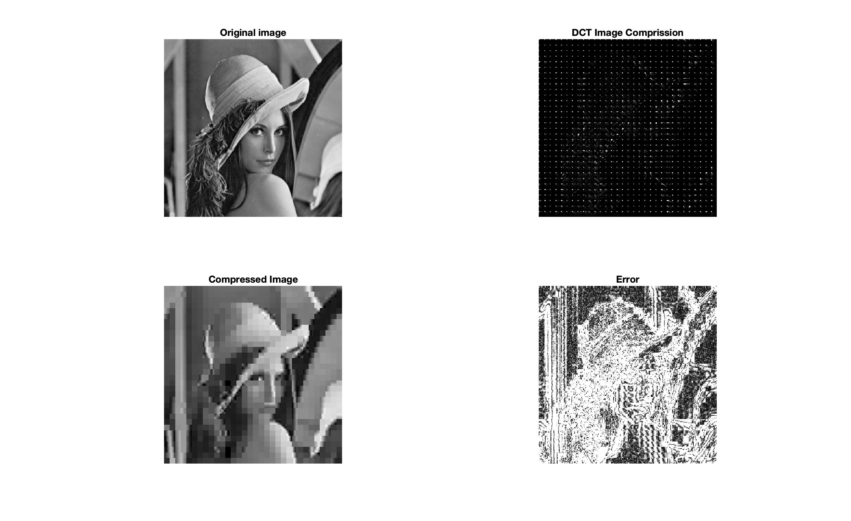
Task 2: Block-based DCT-domain Image Compression
The image is imported and divided into
non-overlapped blocks,(8x8 pixel size).
Apply 2D DCT to each block
Image compression is achieved by
removing small value DCT coefficients
Global thresholding was used with a target of
98% compression ratio
Compressed image is generated by inverse DCT
PSNR and MSSIM values were calculated and used
for image quality evaluation.
Quality of compressed image in block-based DCT
was better than that of the block-based DCT

Slide 9

Task 3: Sub-band Image Compression using Wavelets
Compression based on wavelet method
was achieved by in-built MATLAB function
The original image and the compressed image
were compared, and an error calculation was done
PSNR and MSSIM values were calculated and used
for image quality evaluation.
Generally, wavelet is better than block-based
Notes:
sub-images in the bands (LH, HL and HH), and the next level which is a further decomposition of LL into 4
smaller sub-images (LL, LH, HL, HH). This process is repeated for each level.

Slide 10
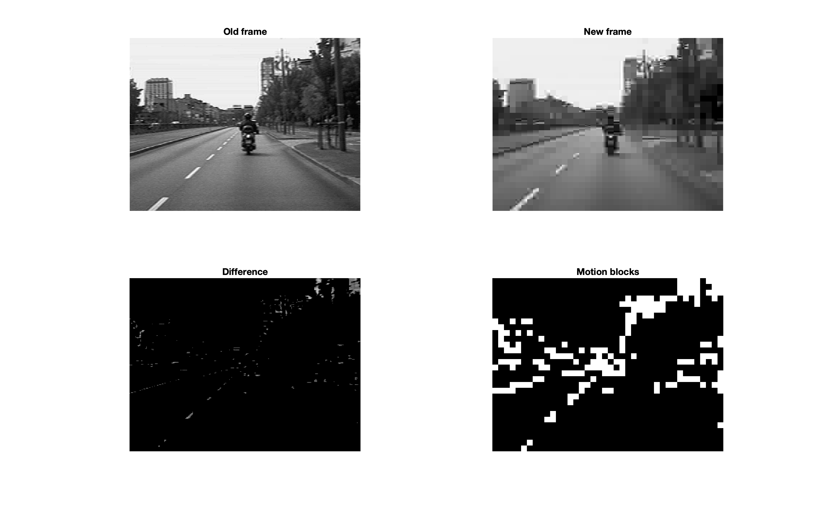
Task 5 & 6: Computation of threshold and motion vectors
Extract 2 frames from the video
Determine the difference between them
Threshold was based on global search
Divide difference image to 8x8 blocks
Then, motion image is determined by
calculating the MSE

Slide 11
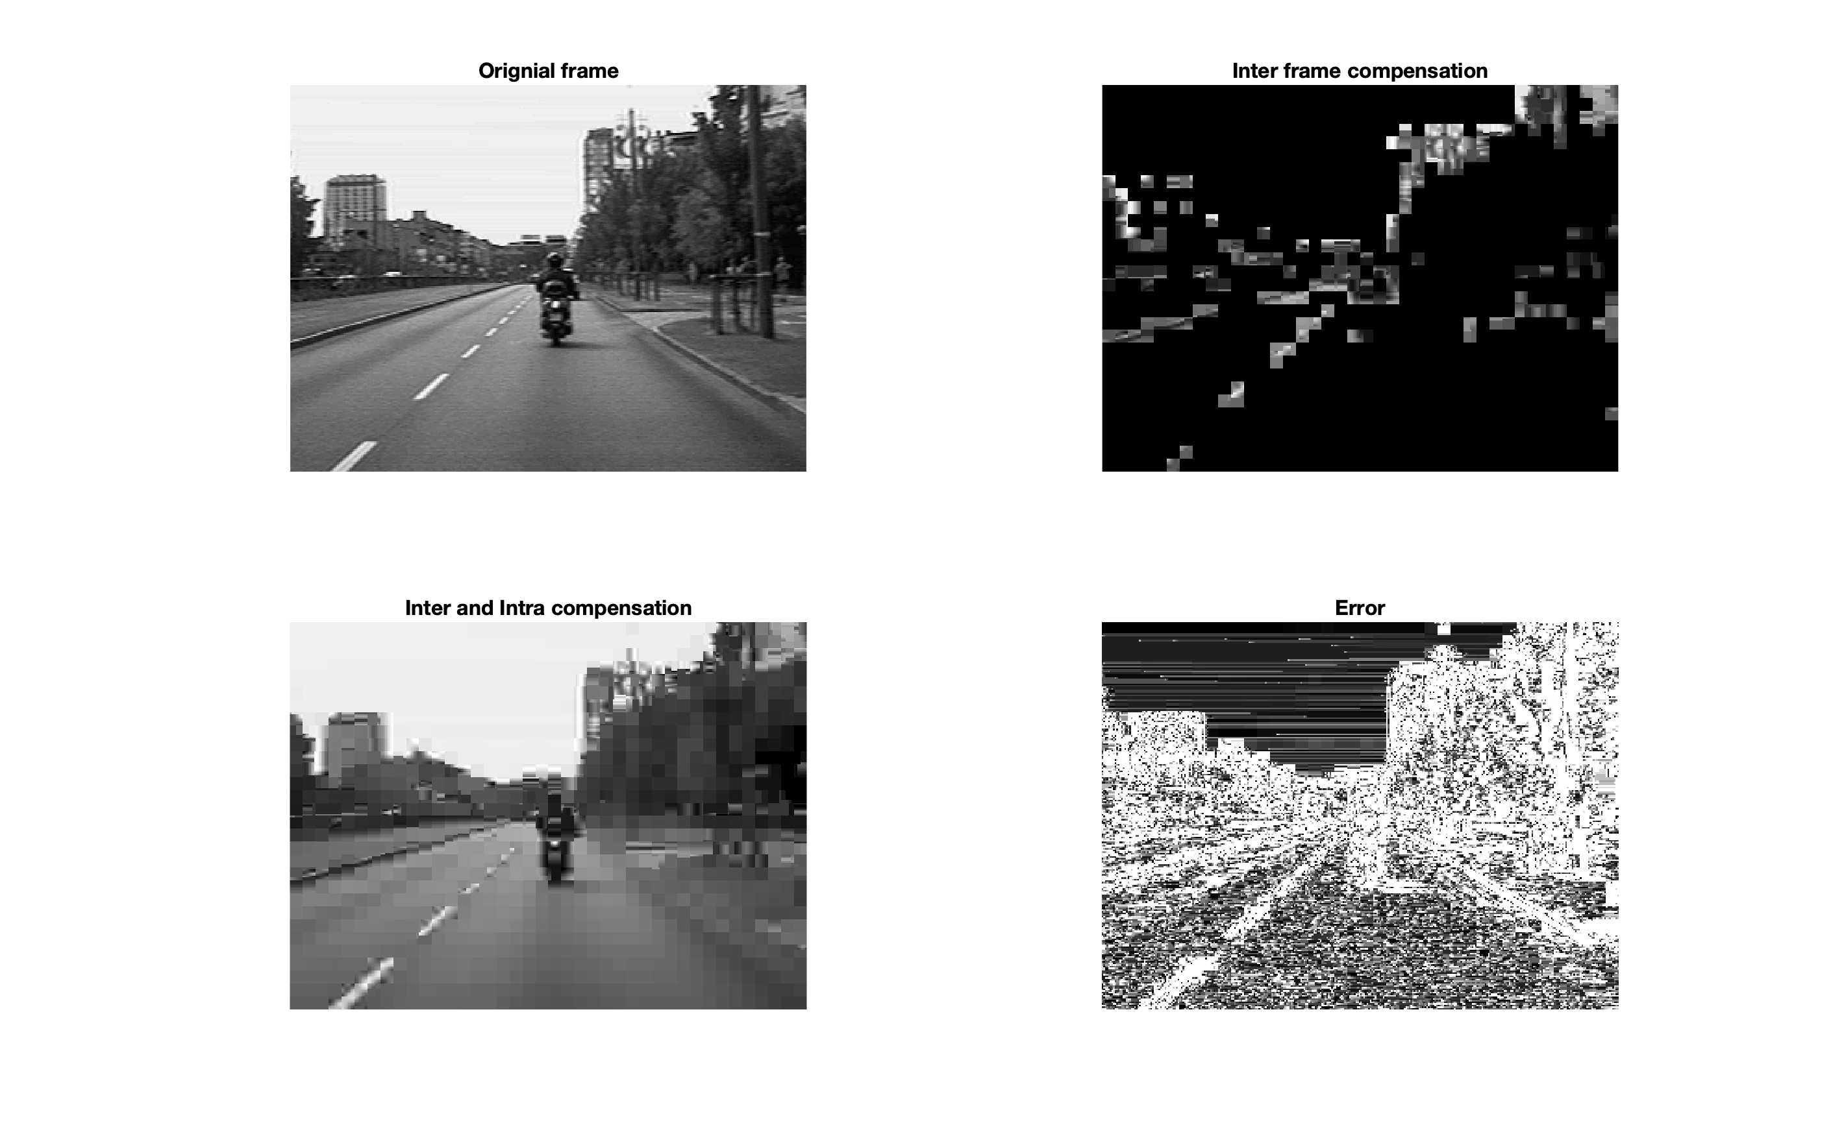
Task 7 & 8: Motion Compensation and image quality
Compute motion vectors blocks by global search on all the blocks to get the best block, using MSE
An all zeros matrix that is filled by values in the
shifted block in the old image by using motion
vector. This gives the motion compensation image
Intra-processing of non-motion blocks by
copying previous blocks.
Quality analysis using PSNR and MSSIM
Notes:
The structural similarity (SSIM) index is a method for predicting the perceived quality of digital television and cinematic pictures, as well as other kinds of digital images and videos
SSIM is designed to improve on traditional methods such as peak signal-to-noise ratio (PSNR) and mean squared error (MSE).

Slide 12

Summary
Compression is achieved by taking out redundant and irrelevant information
Compression can be lossy or lossless
Compression modes are intra and inter modes
Wavelet is a better than block-based DCT for image compensation
Motion compensation is the efficient solution for video compression
PSNR and MSSIM are good indices for measuring reconstructed image quality

Slide 13
Thank You

